Slide 1
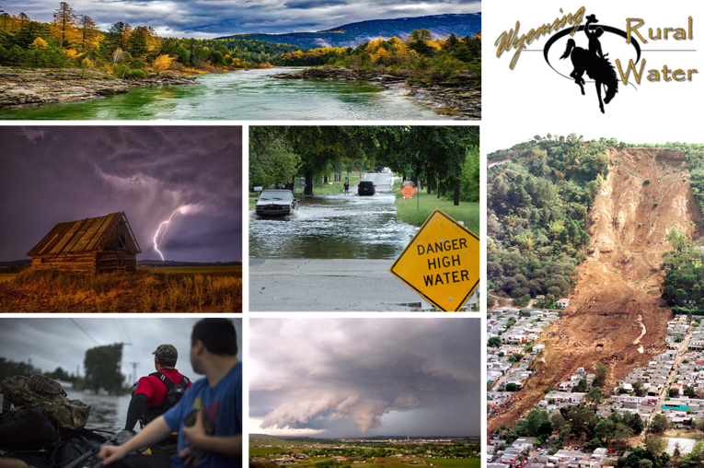
Wyoming Water Emergency Response Exercise
Exercise Briefing
September 26, 2017

Slide 2
Welcome and Overview
Mr. Kevin Tingley
U.S. Environmental Protection Agency
Water Security Division
Mr. Mark Pepper
Wyoming Association of Rural Water Systems
Mr. Nitin Natarajan
The Cadmus Group

Slide 3
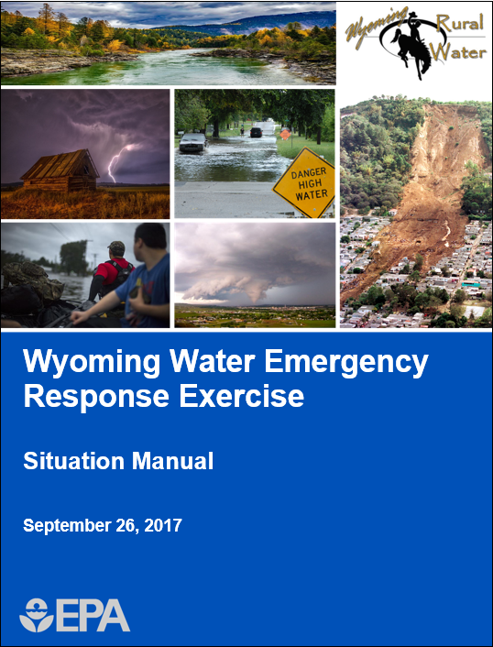
Exercise Overview
Exercise scope:
8 hour discussion-based tabletop exercise (TTX)
3 modules conducted as facilitated plenary discussions and breakout group discussions
The exercise is limited to participants in the room
Mission areas:
Response
Recovery

Slide 4
Objectives and Core Capabilities
Exercise Objective | Core Capability
1. Explore and clarify the roles and responsibilities of the water sector, federal, state, and county agencies, and emergency management in responding to water and wastewater emergencies | Planning Situational Assessment
2. Examine the operational coordination and communication processes among stakeholders during water and wastewater emergency response | Operational Coordination Operational Communication
3. Assess the process of delivering coordinated, prompt, reliable, and actionable information to the community during a water/wastewater incident | Public Information and Warning
4. Discuss actions and resources needed to restore water and wastewater services and identify short and long-term recovery needs | Infrastructure Systems

Slide 5
Exercise Schedule
Activity | Time
7:30 AM – 8:00 AM | Registration and Check-in
8:00 AM – 8:20 AM | Welcome and Introductions
8:20 AM – 8:30 AM | Exercise Overview
8:30 AM – 10:00 AM | Stakeholder Presentations
10:00 AM – 10:10 AM | Break
10:10 AM – 10:40 AM | Stakeholder Presentations
10:40 AM – 12:00 PM | Module 1: Initial Incident
12:00 PM – 1:30 PM | Lunch
1:30 PM – 2:50 PM | Module 2: Response
2:50 PM – 3:00 PM | Break
3:00 PM – 4:20 PM | Module 3: Recovery
4:20 PM – 4:30 PM | Closing Remarks
4:30 PM – 5:00 PM | Hot Wash

Slide 6
Participant Roles and Responsibilities
Players: Respond to situation presented based on current plans, policies, and procedures
Observers: Support players in developing responses, but do not participate in moderated discussion
Facilitators: Provide situation updates and moderate discussions

Slide 7
Exercise Structure
The facilitated discussion-based tabletop exercise will consist of three modules alternating between plenary discussions and breakout group discussions:
Module 1 will focus on initial incident operations within the 0 – 1 day timeframe
Module 2 will focus on response operations within the 1 – 2 day timeframe
Module 3 will focus on recovery operations within the 1 week to 1+ month timeframe
Table Discussion
Participants engage in table discussions and
prepare out briefs for the plenary
Scenario Update
Facilitator provides scenario update and discussion guidance
Plenary Discussion
Participants engage in larger group discussion of out briefs

Slide 8
Exercise Guidelines
This is an open, low-stress, no-fault environment. Varying viewpoints, even disagreements, are expected
Base your responses on the current plans and capabilities of your organization
Decisions are not precedent setting; consider different approaches and suggest improvements
Issue identification is not as valuable as suggestions and recommended actions that could improve response and/or recovery efforts; problem-solving efforts should be the focus

Slide 9
Assumptions and Artificialities
The exercise is conducted in a no-fault learning environment wherein capabilities, plans, systems, and processes will be evaluated
The exercise scenario is plausible, and events occur as they are presented
All players receive information at the same time

Slide 10
Stakeholder Presentations

Slide 11
Module 1 Overview: Initial Incident (1/2)
Tuesday, June 12, 2018
Radar indicates a large storm system forming in southeastern Idaho is depositing significant amounts of rain as it moves northeast at about 40 mph
Forecasts indicate that the system may produce severe storms in eastern Idaho, Utah, and Wyoming
Rain begins to fall in parts of western Wyoming around 1:00 PM on Tuesday, June 12
At 3:00 PM, the National Weather Service (NWS) issues a Severe Thunderstorm Watch for a large portion of western Wyoming including Teton, Lincoln, Sublette, Fremont, and Sweetwater counties

Slide 12
Module 1 Overview: Initial Incident (2/2)
The NWS issues a Severe Thunderstorm Warning for Teton, Lincoln, Sublette, and Fremont counties at 7:45 PM
Wind gusts up to 70 mph, hail measuring 1.5 inches in diameter, frequent lightning, and heavy rains are associated with the storm
Warnings indicate that most damage will be caused by cloud-to-ground lightning and flash flooding
Widespread damage is expected to roads, vehicles, homes, and utilities

Slide 13
Module 1: Initial Impact
The thunderstorm moves into northern Lincoln and southern Teton counties at 8:10 PM
There are reports of sporadic power outages and downed power lines in several locations across the county
In Jackson, lightning strikes a cell phone tower causing outages throughout the area
Flash floods are reported in the towns of Daniel, Cora, and Pineland
Thunderstorms begin to dissipate around 9:15 PM as the storm moves east towards Sublette County
Heavy rain continues and forecasts indicate additional severe thunderstorms are likely to occur in the area
Notes:
Facilitators: Provide an example.

Slide 14
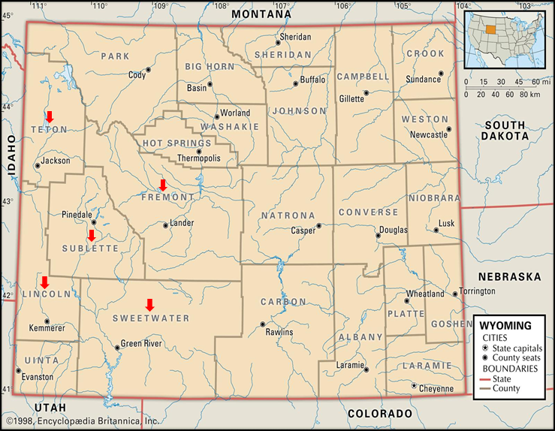
Breakout Group Discussions
Discuss Module 1 discussion questions
Prepare an out brief for plenary discussion

Slide 15
Lunch Break

Slide 16
Module 2 Overview: Response (1/2)
Tuesday, April 12 – Friday, April 14
Officials continue to assess damages caused by the storm and have initiated search and rescue operations in all 3 affected counties
2 fatalities have been confirmed as a result of car accidents
There are widespread power outages in Lincoln and Teton counties due to downed transmission lines along Highway 89
Emergency crews who rely on cell phones must find alternative forms of communication
There is severe risk of flooding in Afton and surrounding areas from the Salt River, Spring Creek, and Crow Creek
2:25 AM, Wednesday, June 13 a landslide occurs on Highway 191 north of Hoback, near the Highway 89 split, blocking both lanes

Slide 17
Module 2 Overview: Response (2/2)
As of 9:00 AM, June 13, the full extent of damage is unknown
Facilities in Afton, Jackson, and Pinedale are experiencing communications failures and structural damage
Officials suspect potential water contamination in the Pinedale and Jackson areas due to several water main breaks
At 1:00 PM dozens of households begin calling about out-of-service wells and septic systems
St. John’s Hospital is running on backup generators and is experiencing an increase in patients as the injured from throughout the region are being transported there
4 people have self-admitted with fears of having consumed contaminated water

Slide 18
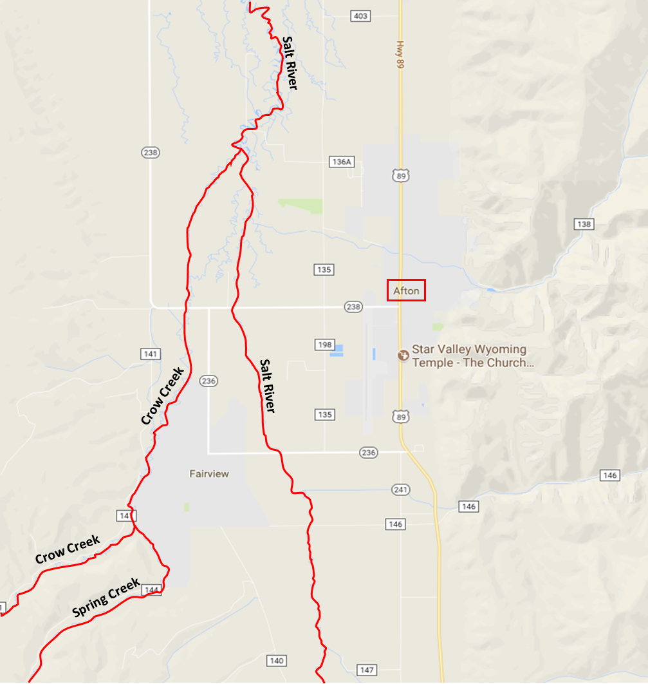
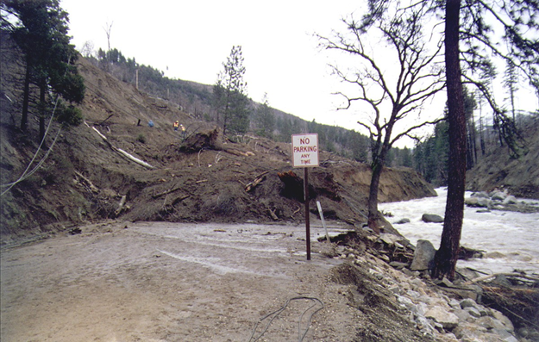
Breakout Group Discussions
Discuss Module 2 discussion questions
Prepare an out brief for plenary discussion

Slide 19
Break (10 Minutes)

Slide 20
Module 3 Overview: Recovery
One Week to One Month After the Incident
In total, rainfall includes 5 inches in Afton, 4.5 inches in Pinedale, and 4 inches in Jackson
Most customers regained power within 3 days, but some remain without power
In total, there were 5 deaths and 50 injuries caused by the storm
Transportation continues to be a challenge due to blocked major routes and damaged response/utility vehicles
There are widespread distribution problems due to line and pipe breaks
Hundreds of households may be without potable water for several weeks due to distribution problems and widespread contamination
Many households will be under boil water advisories for the foreseeable future

Slide 21
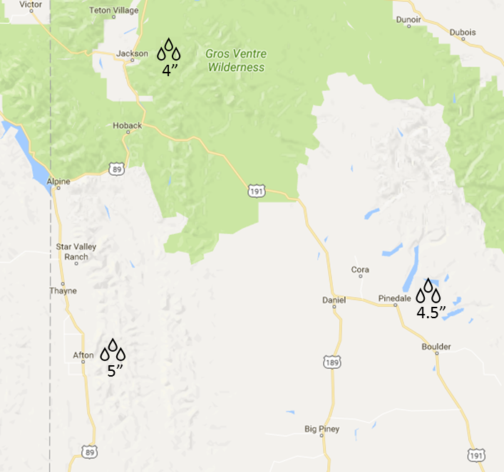
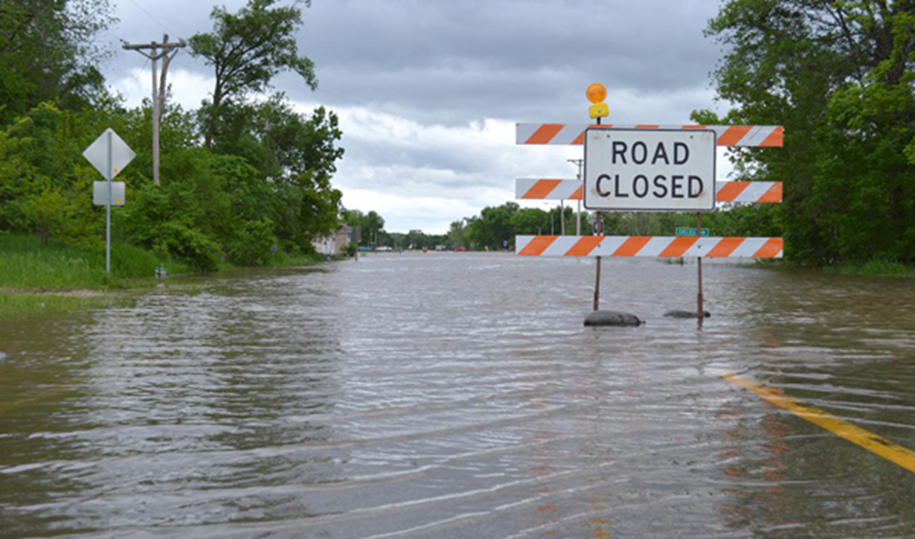
Breakout Group Discussions
Discuss Module 3 discussion questions
Prepare an out brief for plenary discussion

Slide 22
Closing Comments
Mr. Kevin Tingley
U.S. Environmental Protection Agency
Water Security Division

Slide 23
Hot Wash

